Slide 1
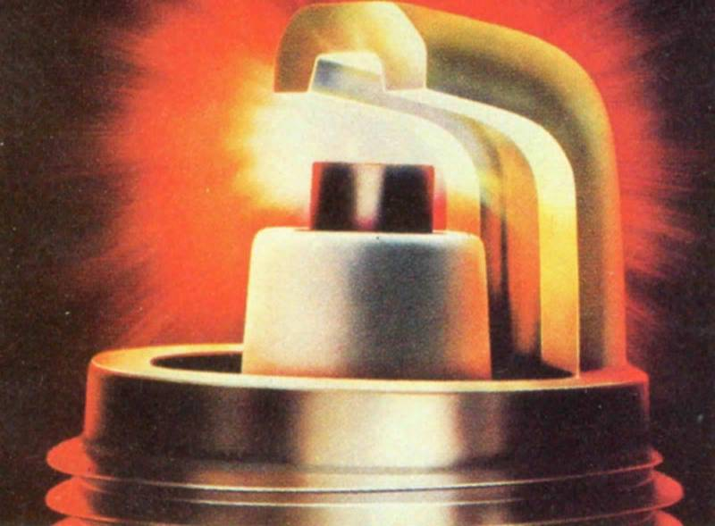

Spark Plugs
By Vance Bloom

Slide 2
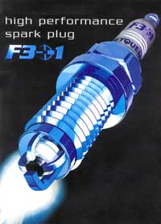
Q. What is the function of a spark plug and why is it a vital engine component?
A. The function of the spark plug is to introduce the ignition energy into the combustion chamber to initiate combustion of the compressed air-fuel mixture. It accomplishes this task by generating a spark (60,000 K) between its electrodes, which then generates the required heat to ignite a smooth burn of the air/fuel mixture.
It must permit reliable cold starting, it must guarantee that there is no misfiring during acceleration, and it must withstand the engine being operated for hours on end at maximum power.
These requirements apply throughout the entire service life of the spark plug.
Today, the continuously developing spark plug is a key engine system component.
It plays a major role in fuel economy, clean, efficient combustion, and the reliable operation of engines and catalytic converters.

Slide 3
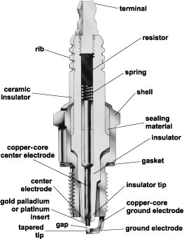
Q. What are the parts of a
Spark Plug?

Slide 4

Q. Why do we need to change spark plugs?
A. During operation, the spark plug is subjected to both wear and to fouling and should be replaced at regular intervals.
In the course of its service life, the spark plug undergoes changes that increase the required ignition voltage. When the required voltage reaches a level that can no longer be compensated for by the voltage reserve, the result is misfiring.
These changes can be caused by:
• Electrode wear
• Engine wear
• Abnormal operating conditions
(pre-ignition, detonation, high oil
consumption)

Slide 5
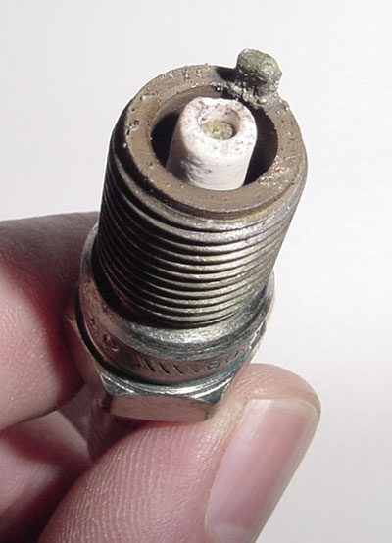
Q. How often do I need to change my plugs?
A. As a rule, you should follow the recommended replacement interval listed in your vehicle owners manual, however some technicians highly recommend that you inspect (read) your spark plugs annually and replace as required, to insure optimum engine performance.
Overheated

Slide 6
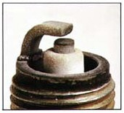
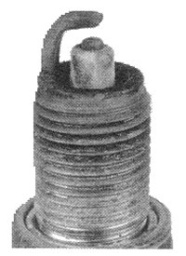
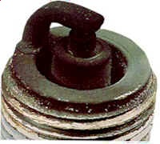
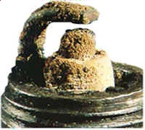
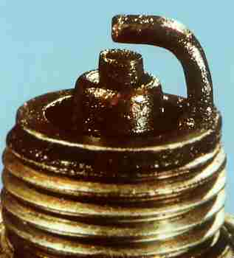
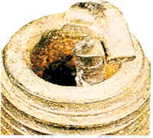
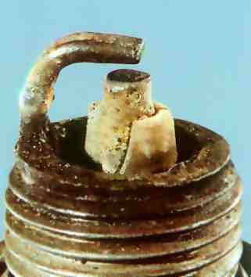
Q. How do I evaluate/read my spark plugs?
Normal
Worn
Carbon Fouled
Overheated
Ash Deposits
Oil Fouled
Mechanical Damage
Detonation

Slide 7


Q. How do we adjust the electrode gap?
The gap setting has to be adjusted according to the vehicle manufacturer’s specifications. To avoid damage to a spark plug in the process of adjusting the gap, it is important to follow these guidelines:
• To widen the electrode gap, use a tool that only pulls back the ground electrode, without applying pressure to the center electrode. The tool must not be wedged between the electrodes as that may cause damage to the insulator nose.
• To close the electrode gap, carefully tap the plug, electrode first, on a hard surface, as shown in the illustration.

Slide 8
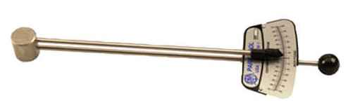
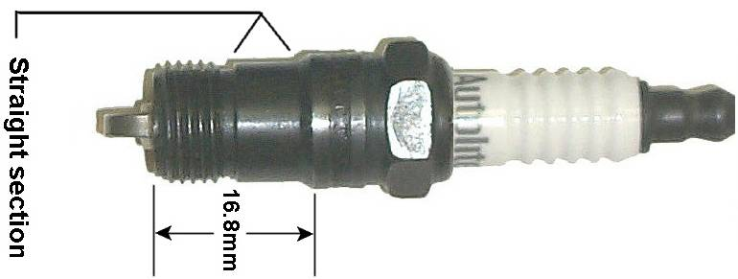
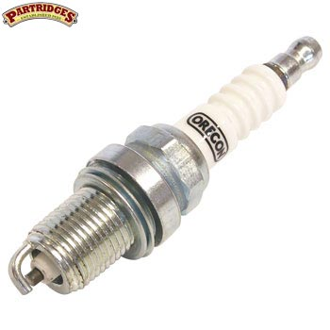
Q. How should spark plugs be tightened for best performance?
A. Manufacturers recommend when installing spark plugs to use a torque wrench and the correct torque in ft.-lbs. As listed below:
Torque FT.-LBS.
10mm With Gasket 8-11
12mm With Gasket 12-15
14mm With Gasket 19-22
14mm Tapered Seat 12-15
18mm With Gasket 20-23
18mm Tapered Seat 14-17
If a torque wrench is not available, hand tighten the plug until it is seated in the cylinder head.
Spark plugs with gaskets should be tightened an additional 90°.
Spark plugs with tapered seats should be tightened an additional 15°.
NOTE: AVOID OVER TIGHTENING OR UNDER TIGHTENING AS SPARK PLUG OR ENGINE DAMAGE MAY RESULT.

Slide 9
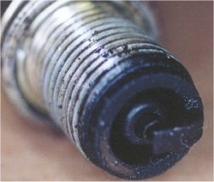
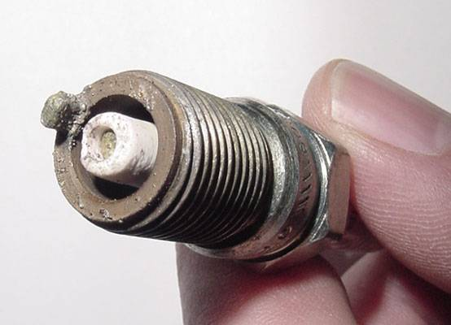
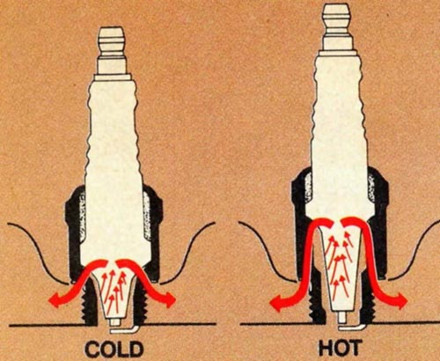
Q. What is a heat range?
Too Cold !
Too Hot!
A. The spark plugs’ heat range is an index of its capacity to dissipate thermal energy. The different characteristics of automotive engines regarding operating load, compression, engine speed, cooling, and fuel make it impossible to run all engines with a standard spark plug. The same spark plug may get very hot in one engine type, but may reach only a relatively low temperature in 3 another. In the first case, the air-fuel mixture would ignite on the glowing parts of the spark plug projecting into the combustion chamber (pre-ignition) and, in the second case, the insulator tip would soon become so badly fouled by combustion deposits that misfiring would occur. To ensure that the plug runs between the desired temperatures, plugs with different heat capacities were developed. The so called “heat range”, which is assigned to each spark plug, is used to characterize these heat dissipation capacities. A plug with a low heat range number (e.g., 2-4) indicates a cold plug that quickly dissipates heat to the engine block and cooling system, while a high code (e.g., 7-10) indicates a hot plug that retains heat. By properly selecting the heat range of the plug, it ensures that the plug will operate between the plug’s designed operating range of 500- 900 degrees Celsius. In this range, the spark plug will be self-cleaning, yet will not be hot enough to pre-ignite the air/fuel mixture.

Slide 10
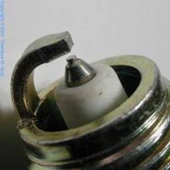
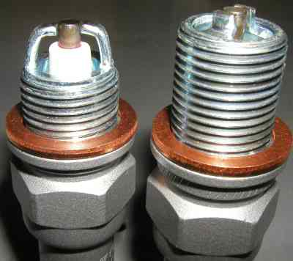
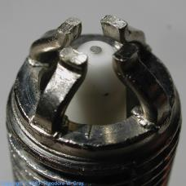
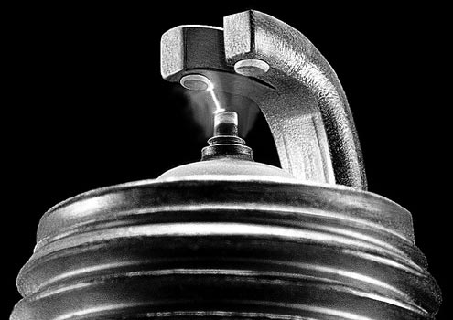
Q. How do I decide which spark plugs to buy?
What type of plug lasts the longest?
Which spark plug is the best value for my money?
What does the factory recommend?

Slide 11

NOW FOR A QUIZ!
Click on Icon Above to take quiz.

Slide 12
Questions?
http://www.euromotoelectrics.com/BOSCHSPFAQ.pdf
Modern Automotive Technology, By James Duffy. Chapter 47
http://en.wikipedia.org/wiki/Spark_plug
http://www.stealth316.com/2-sparkplugtech.htm#j1

